Slide 1
SQL Assessment
By Ankur Bansal

Slide 2
Assumptions
It is assumed that the requirement shared under the assessment will be controlled by a web UI page, which we have the following panels.
One panel by which Admin will be able to add, remove and manipulate products and its attributes
For this purpose, we have created ‘Attributes’, ‘Product’ tables (Script shared) and ‘sp_InsertAttribute’, ‘sp_InsertProduct’ as stored procedures.
One panel that will be used by the User, which will help them to select products as per their requirement and order them. For this purpose, we have created ‘Order’ table and ‘sp_CreateOrder’ as stored procedure.
One panel where admin can add or remove product and its attributes mapping. It means admin can have a master list of all the attributes and that can we mapped to the products as per his requirement. For this purpose we have created ‘ProductAttributeMapping’ and ‘sp_InsertProductAttribyeMapping’ as stored procedure.
It is believed that all these UI panels will not be created by me, we will only provide support to the UI developer so that they are able to store data in the database.
If any new attribute is added in ‘Attributes’ by the admin, it will automatically added in ‘Order’ table
But those columns has to be added in ‘sp_CreateOrder’

Slide 3
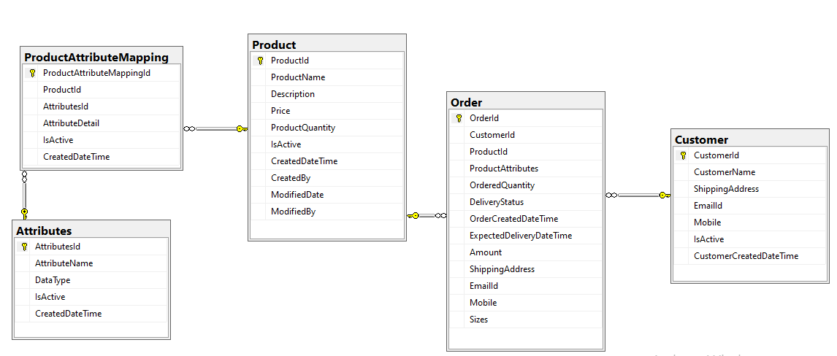
ERD

